Slide 1


2 Peter 1:10-11

Slide 2
Growing in Holiness
in Light of the Promised Blessed Hope of the Lord and Savior’s Soon Return

Slide 3
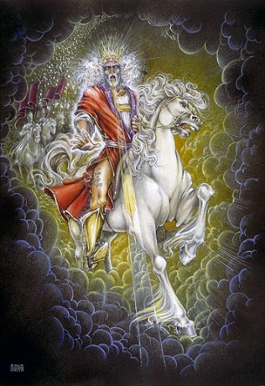
Growing in Holiness
2 PETER
The Blessed Hope is the certainty that our God and Savior Jesus Christ is retuning soon, just as He promised to rescue His church before the Day of the Lord, and at the very end the world is going to burn. In light of this Peter tells us how we should then live.
Notes:
The message of Second Peter is about hope.
Peter tells us to put our hope in Christ, to live in the expectation of the prophetic promises of Jesus’ soon return to establish His glorious kingdom on earth until the conclusion of all things, and then at that time He will create an new heaven and new earth in which only righteousness will exists.
The more we are rooted in this promise and hope, the more we ought to live in holiness, adding good moral conduct to our faith, persevering in the midst of personal trials, and developing our Christian character all in the expectation of being rewarded with a rich entrance to Jesus’ future kingdom without end.

Slide 4
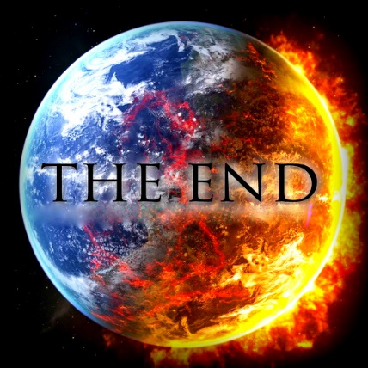
Growing in Holiness
2 PETER
Key Verse:
“Therefore, since all these things will be dissolved, what manner of persons ought you to be in holy conduct and godliness” (2 Peter 3:11)
Notes:
“Therefore, since all these things (the heaven, the elements, the earth and the works that are in it) will be dissolved (loosen), what manner of persons ought you to be in holy conduct and godliness” (2 Peter 3:11)

Slide 5
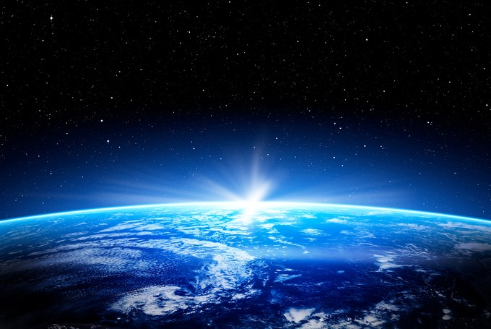
Growing in Holiness
2 PETER
A Verse of Hope:
“Nevertheless we, according to His promise, look for new heavens and a new earth in which righteousness dwell” (2 Peter 3:13)
Notes:
We do not have to fear the apocalypse, “the end of the world”. Nor do we have to leave our planet and move to the heavens, but heaven is going to come down to us and make all things new. Peter does not preach a pessimistic message of doom and gloom, but teaches a lesson of light appearing out of darkness, from doom to bloom.

Slide 6
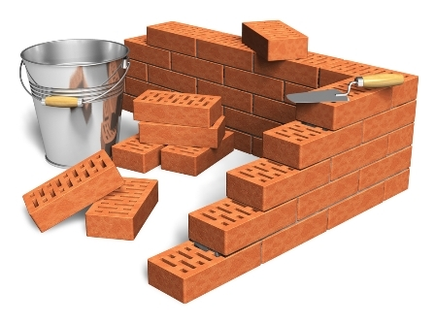
Growing in Holiness
2 PETER
The Prologue of the Letter – 1:3-11
The Basis of Holiness – 1:3-4
Notes:
Peter as a good shepherd is concerned about the moral character of his flock and the dangers that threaten them. He first reminds them of the basis of their holiness, the gracious provision of power and promises that God has provided for their growth in holiness (vs. 3-4) which are the foundational reason why we should follow through and add to our faith.

Slide 7
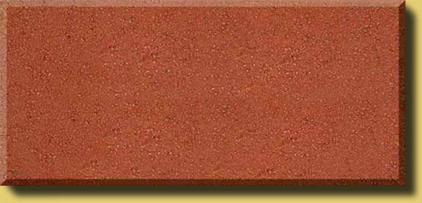
Growing in Holiness
2 PETER
The Prologue of the Letter – 1:3-11
The Basis of Holiness – 1:3-4
PARTAKE
POWER
PROMISE
KNOWLEDGE BASED FATIH
GOD’S GLORY AND VIRTUE
Notes:
Its because of God’s Person, His glory, His moral excellence, holiness and His love for us, that makes everything possible. It is the deepest foundation in whom we trust.
God’s is love, it is the reason that He loved the world and sent His Son as the provision for our salvation. Our faith is based in the knowledge of Christ’s person and provision and proclamation. It is by the means of faith in Christ’s person and His provision that was proclaimed to us, that we received eternal life.
Faith in Christ is also the means by which we are now made recipients of a spiritual equipping and empowering. It is knowledge based faith in Christ that is the means by which we can now access God’s power and promises.
It is God’s divine power that has sufficiently gifted us with all things related to life and godliness. Spirit born believers have all that they could possible need to live a godly life. Nothing else is needed.
God has also given us “exceedingly great and precious promises.” God has given us the promise of eternal life by believing in Christ person, provision and proclamation. In Peter’s second letter the promises that he has most in mind are the promises that God has given us in order that we live godly in this life. And these promises, along with his power, are also the means by which we can become partakers of God’s nature.
The promises Peter has most in mind in this small epistle, are the future prophetic promises of the coming “parousia” of the Lord Jesus Christ. The “Parousia” includes the promise of His physical bodily coming “erchomai” to the earth in the future, in which at that time every eye on earth will see Him. This is the “apocalypse”--the revelation, which is the unveiling or uncovering of the Lord Jesus Christ which bring an end to the age, the Mosaic age.
And especially Peter has in mind the promise of a new heaven and earth in which only righteousness dwells, where there will no sin. At that time he will “wipe away every tear from their eyes; there shall be no more death, nor sorrow, nor crying. There shall be no more pain, for the former things have passed.” (Rev. 21:4) This is the completion of all things.
It is through these very great and valuable prophetic promises that we discover God’s purpose in given them, so that we can “participate”, “become partners” or “sharers” in God’s nature. God’s gift of divine power and promises are the means by which we can partake in His divine nature and work.
One of the great lessons of second Peter is that to maintain a holy life in a corrupt world like ours, we must be deeply fixed in the prophetic promises of God’s word. We must hold fast/stand to the “blessed hope” of the return of our Lord and Savior Jesus Christ. Failing to do so only leads to an absence of readiness. The absence of readiness leads to a loss or future rewards.
The promise of His return has are extremely valuable and importance reliance to our growing in holiness. What we believe concerning His coming has great implications for our life now and in the future.
.

Slide 8
Growing in Holiness
2 PETER
LOVE
BRO. KINDNESS
GODLINESS
The Characteristics
of Holiness – 1:5-7
PERSEVERANCE
SELF CONTROL
KNOWLEDGE
VIRTUE
FAITH
Notes:
But we need to know what that divine nature looks like, so Peter gives us the characteristics of holiness, telling us to diligent to add to our faith.

Slide 9
Growing in Holiness
2 PETER
LOVE
“For if these things are yours and abound, you will be neither barren nor unfruitful in the knowledge of our Lord Jesus Christ. (1:8)
BRO. KINDNESS
GODLINESS
PERSEVERANCE
SELF CONTROL
KNOWLEDGE
VIRTUE
FAITH
Notes:
And if we add or apply these characteristics to our lives we will become ever increasing fruitful and productive in favor and knowledge of our Lord Jesus Christ. The absence of these qualities may results not only with stagnate growth and dead faith, but being led away with the error of the wicked (3:17)
You therefore, beloved, since you know this beforehand, beware lest you also fall from your own steadfastness,… grow in the grace and knowledge of our Lord and Savior Jesus Christ.” (2 Peter 3:17-18)

Slide 10
Growing in Holiness
2 PETER
LOVE
“For he who lacks these things is shortsighted, even to blindness, and has forgotten that he has been cleansed from his old sins.” (1:9)
BRO. KINDNESS
GODLINESS
PERSEVERANCE
SELF CONTROL
KNOWLEDGE
VIRTUE
FAITH
Notes:
Peter adds that he who lacks these things is shortsighted (“nearsighted”) and virtually blind, forgetting that he was saved. Those believers or Christians who fail to diligently seek these characteristics in their life have difficultly seeing things in the relative distant future and past.
Peter has in mind those who have shortsighted views of the coming of the Lord in terror and glory. Peter knows that there are many, including the deceiver himself, who wants to get our eyes off the future and give all our attention to the immediate. Peter tells of false teachers who are already here now, and are coming in increasing numbers.

Slide 11
Growing in Holiness
2 PETER
Warning!
Notes:
Therefore, Peter writes this second letter as a permeant reminder and warning not be caught off guard by shortsighted/nearsighted” false teachers and false teachings concerning the Second Coming. There will be much more to say concerning these nearsighted false teachers and views as we progress through this letter.

Slide 12
Growing in Holiness
2 PETER
LOVE
Basis
BRO. KINDNESS
Power and Promises
GODLINESS
PERSEVERANCE
Personal Results -
Positive and Negative
SELF CONTROL
KNOWLEDGE
VIRTUE
FAITH
Notes:
But for now, “Peter has thus far argued for the moral development presented (5-7) on the basis of (1) God’s gracious powerful and promised provisions for Christian living (3-4), and on the basis of personal results, both positive and negative, that the presence or the absence of these traits produce (8-9).” [Hodges, p. 27]

Slide 13
Growing in Holiness
2 PETER
LOVE
Positively
BRO. KINDNESS
These qualities produce active, fruitful Christians.
GODLINESS
PERSEVERANCE
Negatively
SELF CONTROL
The absence of these qualities leads to a blind and shortsighted life.
KNOWLEDGE
VIRTUE
FAITH
Notes:
In verses 8-9 he states the case positively, that if these qualities are diligently pursued it will produce active, fruitful Christians and he states the case negatively that those who fail to diligently pursue these attributes leads to a blind and shortsighted life which God’s past grace is seemly forgotten.

Slide 14
Growing in Holiness
2 PETER
LOVE
Basis
BRO. KINDNESS
Power and Promises
GODLINESS
PERSEVERANCE
Personal Results -
Positive and Negative
SELF CONTROL
KNOWLEDGE
Proof and Praise
VIRTUE
FAITH
Notes:
Peter is now going to argued that these traits of moral development (5-7) should motivate us to increased diligence on the basis of a broader scope. For these results (10-11) include Proof of our calling and choosing for service, and plentiful Praise before all those under heaven.

Slide 15
Growing in Holiness
2 PETER
LOVE
Reason #1
BRO. KINDNESS
An active, fruitful, and farsighted Christians.
GODLINESS
PERSEVERANCE
Reason #2
SELF CONTROL
Certification of your call and election (for service), climaxed with a rich entrance into His Kingdom.
KNOWLEDGE
VIRTUE
FAITH
Notes:
Now, the first reason (8-9) for moral development was quite adequate to motivate diligence in spiritual growth. The personal results of diligently seeking these traits (5-7) affects our present quality of life (8-9). But the second reason (10-11) these traits should motivate us to increased diligence are the results of a broader scope. For these results include verification of our election and a magnificent entrance into the coming kingdom of God. He instructs us “to make sure our call and election”.

Slide 16
Growing in Holiness
2 PETER
LOVE
“Therefore, brethren, be even more diligent to make your call and election sure, for if you do these things you will never stumble;” (1:10)
BRO. KINDNESS
GODLINESS
PERSEVERANCE
SELF CONTROL
KNOWLEDGE
VIRTUE
FAITH
Notes:
Here is the conclusion to the introduction, “therefore”. In view of these facts, “therefore, brethren” diligence is all the more desirable in developing such a lifestyle. “be even more diligent” implies that diligence should increase. Peter is saying, “After what I have just said about these qualities (characteristics of holiness), you have all the more reason to be diligent.” Peter does not simply repeat the earlier command to diligently add these qualities to faith, but further instructs his readers “to make their call and election sure”.

Slide 17
Growing in Holiness
2 PETER
LOVE
“Therefore, brethren, be even more diligent to make your call and election sure, for if you do these things you will never stumble;” (1:10)
BRO. KINDNESS
GODLINESS
PERSEVERANCE
SELF CONTROL
KNOWLEDGE
VIRTUE
FAITH
Notes:
The word, “sure” bebaios (beb'-ah-yos); comes from the idea of a stable base; Moulton and Milligan writes the technical word and its equivalents signifies a legally guaranteed security. To be “sure” of something is “to certify, confirm or attest” to its validity or soundness, its proof.
Notice “brethren”. It is the brethren (brothers and sisters in Christ) who are those who make their calling and election sure. It’s not God who does so, but it is us.
Still less it is not the brethren/Christians who are instructed to make their calling and election (“to eternal life” AKA “salvation”) to themselves. Peter has just finished addressing his readers as “those who have obtained like precious faith (eternal life) with us” (1:1). Moreover, Peter unmistakably treats his readers as Christians whom God has richly gifted with power and promises, so that they make partake in God’s very own divine nature.
In fact, Peter calls them steadfast believers (3:17) who are in danger of falling from their steadfastness, not their salvation. They are not believers who are in doubt of their call and election to salvation.

Slide 18
Growing in Holiness
2 PETER
“To suggest that despite these direct statements by the Apostle, his readers are still uncertain about their call and election to eternal life, is to force on the text an alien theological presupposition. The idea is… the torturing of the text into conformity with a preconceived opinion” [Hodges, p. 29]
Notes:
“To suggest that despite these direct statements by the Apostle, his readers are still uncertain about their call and election to eternal life, is to force on the text an alien theological presupposition. The idea is… the torturing of the text into conformity with a preconceived opinion” [Hodges, p. 29]

Slide 19
Growing in Holiness
2 PETER
LOVE
“Therefore, brethren, be even more diligent to make your call and election sure, for if you do these things you will never stumble;” (1:10)
BRO. KINDNESS
GODLINESS
PERSEVERANCE
SELF CONTROL
KNOWLEDGE
VIRTUE
FAITH
Notes:
Who are the “brethren” and how do you become one?
The “brethren” from our standpoint they are “spiritual brothers and sisters in Christ”. From God’s standpoint they are the children of God.
How do you become a spiritual brother or sister in Christ, a child of God? – By being place into the body of Christ. (1 Cor. 12:12-13, 27). And when and how does that happen? When you – believed in Christ -- “But as many as received Him, to them He gave the right to become children of God, to those who believe in His name:...” (John 1:12)
Now, Jesus told us himself, “Who is My mother and who are My brothers?"
The gospel account of Matthew records on an occasion when Jesus was still talking to the multitudes, behold, His mother and brothers stood outside, seeking to speak with Him. Then one said to Him, "Look, Your mother and Your brothers are standing outside, seeking to speak with You." But He answered and said to the one who told Him, “Who is My mother and who are My brothers?" And He stretched out His hand toward His disciples and said, "Here are My mother and My brothers! For whoever does the will of My Father in heaven is My brother and sister and mother.“ (Matt. 12:46-50)
“whoever does the will of My Father” is a technical term for those who have obeyed the command to believe in His Son for eternal life. “And this is the will of Him (the Father) who sent Me, that everyone who sees the Son and believes in Him may have everlasting life; and I will raise him up at the last day.“ (John 6:40)
Now that we have made this clear, do you become then a brother in Christ by obtaining these qualities? Do you prove you are a real brother by demonstrating these qualities? What if you do not abound in these qualities, does it prove you are not a true brother? Are only those who diligently make their calling and election sure, true brothers? No, No, No, and No! Unfortunately, many say yes.

Slide 20
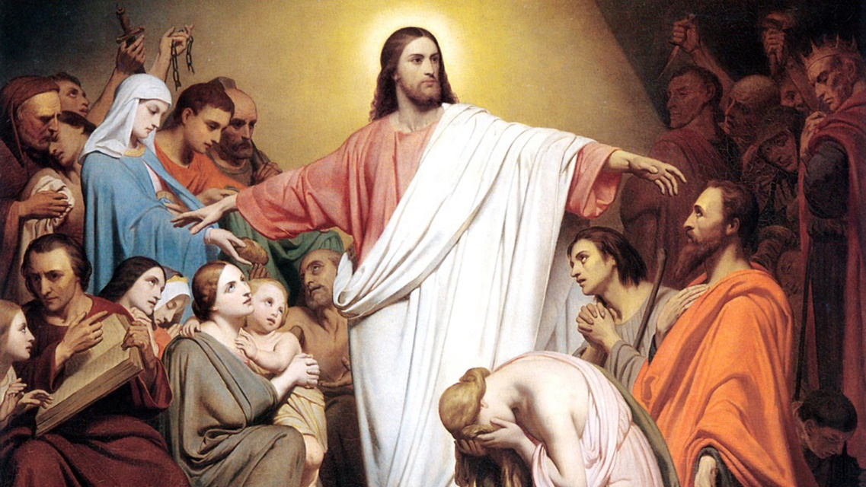
Growing in Holiness
2 PETER
“Then one said to Him, "Look, Your mother and Your brothers are standing outside, seeking to speak with You." (Matt 12:47)
Notes:
Now, Jesus told us himself, “Who is My mother and who are My brothers?"
The gospel account of Matthew records on an occasion when Jesus was still talking to the multitudes, behold, His mother and brothers stood outside, seeking to speak with Him. Then one said to Him, "Look, Your mother and Your brothers are standing outside, seeking to speak with You."
But He answered and said to the one who told Him, “Who is My mother and who are My brothers?" And He stretched out His hand toward His disciples and said, "Here are My mother and My brothers! For whoever does the will of My Father in heaven is My brother and sister and mother.“ (Matt. 12:46-50)
“whoever does the will of My Father” is a technical term for those who have obeyed the command to believe in His Son for eternal life. “And this is the will of Him (the Father) who sent Me, that everyone who sees the Son and believes in Him may have everlasting life; and I will raise him up at the last day.“ (John 6:40)

Slide 21

Growing in Holiness
2 PETER
“But He answered and said to the one who told Him, "Who is My mother and who are My brothers?" And He stretched out His hand toward His disciples and said, "Here are My mother and My brothers! For whoever does the will of My Father in heaven is My brother and sister and mother.“ (Matt 12:48-50)
Notes:
Now, Jesus told us himself, “Who is My mother and who are My brothers?"
The gospel account of Matthew records on an occasion when Jesus was still talking to the multitudes, behold, His mother and brothers stood outside, seeking to speak with Him. Then one said to Him, "Look, Your mother and Your brothers are standing outside, seeking to speak with You."
But He answered and said to the one who told Him, “Who is My mother and who are My brothers?" And He stretched out His hand toward His disciples and said, "Here are My mother and My brothers! For whoever does the will of My Father in heaven is My brother and sister and mother.“ (Matt. 12:46-50)
“whoever does the will of My Father” is a technical term for those who have obeyed the command to believe in His Son for eternal life. “And this is the will of Him (the Father) who sent Me, that everyone who sees the Son and believes in Him may have everlasting life; and I will raise him up at the last day.“ (John 6:40)

Slide 22
Growing in Holiness
2 PETER
LOVE
“Therefore, brethren, be even more diligent to make your call and election sure, for if you do these things you will never stumble;” (1:10)
BRO. KINDNESS
GODLINESS
PERSEVERANCE
SELF CONTROL
KNOWLEDGE
VIRTUE
FAITH
Notes:
The meaning of this verse should be obvious. Given it legal usage “sure” (bebion… poieisthai) can mean “to certify, “to offer valid conformation” – to other. “That is, when a brother develops the character qualities (5-7), he is producing valid evidence, for others to observe, that God has indeed “called” and “chosen” him.
This is James’s doctrine of justification by works before men. Unsaved men are not likely to believe that we are in God’s favor just because we say-so. But a life filled with these moral qualities, capped with love not only for “one another”, but also a love for all, can be very persuasive. As the Lord Jesus put it, “By this all will know that you are my disciples, if you have love for one another” (John 13:35). [Hodges, p. 29]
If this verse was talking about election to salvation as to our being chosen before time (Eph. 1:4) you would expect that the phrase should be reversed, “your election and calling”, as in Romans 8:30 where we read “whom He predestined, these He also called.”
Now this is why in the Bible Knowledge Commentary that Dr. Ken Gangel says, “Election, of course, precedes calling.” [BKC, p. 867] so he presumes it [theologically] precedes calling here. However, here calling [grammatically] precedes election. Gangel gives the traditional Calvinist view—”’Calling’ refers to God’s efficacious work in salvation and ‘election’ is God’s work of choosing some sinners to be saved… A believer shows by his godly life and his growth in the virtues mentioned… that he is one of God’s chosen.” [BKC, p. 867]
In other words, you know you are saved by your very subjective evaluation of our yours own works? Even John MacArthur said this is impossible.
“We are lousy at real evaluation. Paul says my own evaluation is as corrupt as the Corinthians. Only God can evaluate. You don’t ever, ever evaluate your own spiritual life. You are in no position to do it. You’re to bias in your own favor. That’s why the focus of the Christian life is not on the Christian life but is on God. You just keep plugged into God and let the evaluation take care of itself. The Bible says when you are going to be a changed person. 2 Corinthians 3:18 says, not to gaze on yourself, but gaze on the glory of the Lord to be changed into His image by the Holy Spirit. Get your focus were it ought to be. Spiritual introspection doesn’t do you any good because you cannot make a proper evaluation. Focus on God and get outside of yourself.”
John MacArthur, “Examining the Servants of Christ” I Corinthians 4:1-5; Tape #1820
But where do we find this phrase “call and election? You know that Peter’s teachings are based on the teachings he heard from the Lord Jesus Christ Himself. Peter says six verses later, “For we did not follow cunningly devised fables when we made known to you the power and coming of our Lord Jesus Christ, but were eyewitnesses…” (1:16). The sequence (call-choose) brings to mind the famous statement of the Lord that ”many are called, but few are chosen”

Slide 23
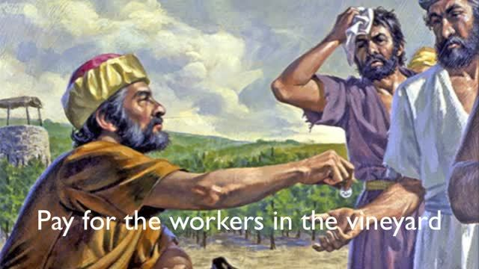
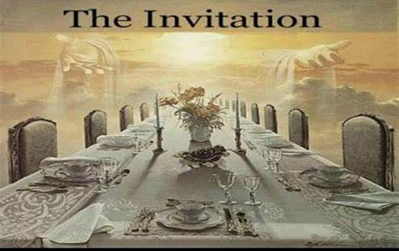
Growing in Holiness
2 PETER
”For many are called, but few are chosen." (Matthew 20:16, 22:14)
The Parable of the Workers of the Vineyard (Matthew 20:1-16)
The Parable of the Wedding Supper (Matthew 22:1-14)
Notes:
These words are found twice in the Gospels, both in Matthew 20:16; 22:14, but are words Peter must have heard many, many times. In any case, these words by Jesus occurs in eschatological contexts, that is the choosing will occur in the future, in the latter days. These words are spoke by Jesus concluding two parables, “The Parable of the Workers of the Vineyard” (20:1-16) which follows the vineyard owner’s decisive pronouncement about the wages of the workers, and “The Parable of the Wedding Supper” (22:1-14) which follows the host’s decisive command to expel the improperly dressed man. So, we see, it has a positive and a negative application.
The parable of the Vineyard workers refers to Christian service up to the Lord’s return for His Church, while the man in the parable of the Wedding Supper concerns those who have not prepared themselves for the host’s review. It can represent believes who are unprepared for the Judgment Seat of Christ, which is the believers evaluation of his service to the Lord by the Lord.
From both parables it is plain to see that the “choice” follows the “call”. The vineyard workers are called or invited to work/serve the Lord, but the choice about their wages is made by the vineyard owner in the evening, that is at the end of the day. Some are “chosen” to receive pay equal to those who worked longer. [God does not pay slave wages, to His workers]. In the Wedding Feast many are “invited” and many turn down the invitation. But even one who came appeared poorly dressed was not “chosen” to participate, although he had been “called”.
Many are called to salvation, many if not most turn down the invitation. Many are called to service for Christ, to take up their cross and follow Him and become His disciples, many are called to add to their faith, many if not most turn down the invitation. Those who heed the call are chosen for further service—The Lord will say to the chosen, 'Well done, good and faithful servant; you have been faithful over a few things, I will make you ruler over many things. Enter into the joy of your master.‘ (Matt. 25:23)

Slide 24
Growing in Holiness
2 PETER
LOVE
“Therefore, brethren, be even more diligent to make your call and election sure, for if you do these things you will never stumble;” (1:10)
BRO. KINDNESS
GODLINESS
PERSEVERANCE
SELF CONTROL
KNOWLEDGE
VIRTUE
FAITH
Notes:
Peter clearly encourages the building of Christian character (5-7) which in turn, leads to Christian activity and fruitfulness (8) This active and fruitful life lead to pay as it did for the vineyard workers. The vineyard workers were given their wages/pay “misthos” which is also a common word in the NT for “reward”. The lifestyle that Peter commands will prepare us to be properly ‘clothed’, when we first meet the Lord in the air, unlike the poorly dressed man who appeared at the wedding feast.
Peter states just such a desire for us in 3:14…

Slide 25
Growing in Holiness
2 PETER
LOVE
“Therefore, beloved, looking forward to these things, be diligent to be found by Him in peace, without spot and blameless.” (2 Peter 3:14)
BRO. KINDNESS
GODLINESS
PERSEVERANCE
SELF CONTROL
KNOWLEDGE
VIRTUE
FAITH
Notes:
“Therefore, beloved, looking forward to these things, be diligent to be found by Him in peace, without spot and blameless;” (2 Peter 3:14) Make sure you have the rights clothes for the occasion.

Slide 26
Growing in Holiness
2 PETER
“just as you know how we were exhorting and encouraging and imploring each one of you as a father would his own children, so that you would walk in a manner worthy of the God who calls you into His own kingdom and glory.” (1 Thess. 2:11-12) [NASB]
Notes:
Peter has given his readers and all believers during the church age, just as Paul did to His readers in Thessalonica a ‘royal’ summons by God Himself, “who calls” [us] into His own kingdom and glory” (1 Thess. 2:12)

Slide 27
Growing in Holiness
2 PETER
“If we endure, we shall also reign with Him.” (2 Timothy 2:12)
“…if children, then heirs — heirs of God and joint heirs with Christ, if indeed we suffer with Him, that we may also be glorified together.” (Romans 8:17)
Notes:
And a significant part of that glory is the privilege of co-reigning with Christ, for Paul says that, “If we endure, we shall also reign with Him.” (2 Tim 2:12), and he also wrote in Romans “…if we are children of God, then heirs — heirs of God, [every believer receives an inheritance], but then goes on the say “and joint heirs with Christ”, [with the qualifier] “if indeed we suffer with Him, that we may also be glorified together.’ (Romans 8:17)
All Christian called to co-reign with Christ, but not all Christians are chosen to co-reign with Christ. All Christians are called to this glory, but not all Christians are chosen to receive it. All Christians are called to take up their cross and follow Him, but not all Christians choose to do so. Many do not choose to stand and remain in His word, choose to serve the Lord, choose to add to their faith and work to the end of the day. Those who do not endure, deny Him, and are denied [not chosen] to reign with Him and be glorified with Him.

Slide 28
Growing in Holiness
2 PETER
LOVE
“Therefore, brethren, be even more diligent to make your call and election sure, for if you do these things you will never stumble;.” (1:10)
BRO. KINDNESS
GODLINESS
PERSEVERANCE
SELF CONTROL
KNOWLEDGE
VIRTUE
FAITH
Notes:
Peter desires his readers to produce in their lifestyle appropriate verification that they are “royal” people, people worthy of reigning with Christ, destined for high honor in the coming kingdom of God. “these things” are the characteristics of holiness that is necessary for royal people to possess. By doing “these things” their road into the glories of that kingdom will be smooth. They will not “stumble” on the path and run the risk of losing the rewards they are “called” to obtain.
For this reason Paul said, “…I discipline my body and bring it into subjection, lest, when I have preached to others, I myself should become disqualified.” (1 Cor. 9:27) Disqualified not from salvation, but from reigning with Christ. Instead those who do these things will prove themselves “elected” for divine reward.

Slide 29
Growing in Holiness
2 PETER
LOVE
“for so an entrance will be supplied to you abundantly into the everlasting kingdom of our Lord and Savior Jesus Christ.” (1:11)
BRO. KINDNESS
GODLINESS
PERSEVERANCE
SELF CONTROL
KNOWLEDGE
VIRTUE
FAITH
Notes:
All born-again believer, God’s children, will enter the kingdom of God, but those who develop the Christian character described here will have a special kind of entrance, an abundant entrance, more precisely they will receive a “rich” entrance.

Slide 30
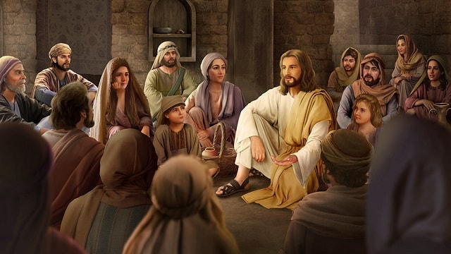
Growing in Holiness
2 PETER
“it is your Father’s good pleasure to give you the kingdom.” (Luke 12:32)
Notes:
Did you know that, “it is your Father's good pleasure to give you the kingdom.” (Luke 12:32) And not only to give it to you, but also to give it to you in abundance.
Jesus told his disciples (12:22-30) not to be concerned about their daily needs, but rely on God to provide them. God knows we need them. Jesus concluded by saying, “Seek ye the kingdom of God, and all these things will be added to you.” (12:31) All of this teaching was preceded by the parable of the rich fool who sought only riches on earth. Jesus said concerning Him that he was not rich toward God for he laid up treasure only for himself. (12:21) From this we can clearly see that seeking and gaining of the kingdom and of heavenly treasures are interwoven themes in the teaching of Jesus.
Jesus concludes his teaching by saying, “For where your treasure is, there your heart will be also.” (Luke 12:34) If your heart is toward God and you are rich toward God, then you will have laid up treasures in heaven and they are there waiting for you. This doctrine pertains to the doctrine of eternal rewards.

Slide 31
Growing in Holiness
2 PETER
LOVE
“for so an entrance will be supplied to you abundantly into the everlasting kingdom of our Lord and Savior Jesus Christ.” (1:11)
BRO. KINDNESS
GODLINESS
PERSEVERANCE
SELF CONTROL
KNOWLEDGE
VIRTUE
FAITH
Notes:
So it is here in 2 Peter 2:10-11. Salvation from hell is not in the picture. Heavenly rewards is the real theme. The holy and fruitful lifestyle in verse 5-8 can be a verification that an individual Christian has not only been “called”, but actually “chosen” for a great reward in God’s future universal kingdom. As we diligently pursue this way of life, doing these things, we will be able to avoid any serious spiritual setbacks. Thus, the pathway of life can climax in a rich entrance into the everlasting kingdom of our Lord and Savior Jesus Christ. Everlasting wealth, or treasures in an everlasting life, in His everlasting kingdom.

Slide 32
Growing in Holiness
2 PETER
LOVE
“Therefore, brethren, be even more diligent to make your call and election sure, for if you do these things you will never stumble; for so an entrance will be supplied to you abundantly into the everlasting kingdom of our Lord and Savior Jesus Christ.” (1:10-11)
BRO. KINDNESS
GODLINESS
PERSEVERANCE
SELF CONTROL
KNOWLEDGE
VIRTUE
FAITH

Slide 33
Second Coming
2 PETER
Conclusion

Slide 34

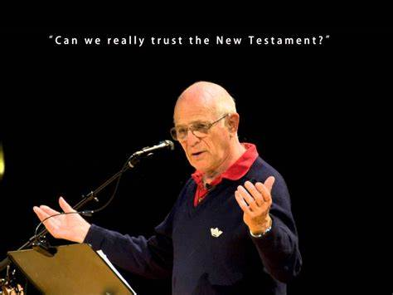
Second Coming
2 PETER
Michael Green

